Slide 1
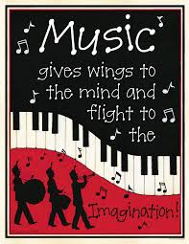
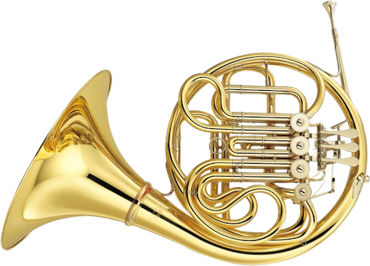
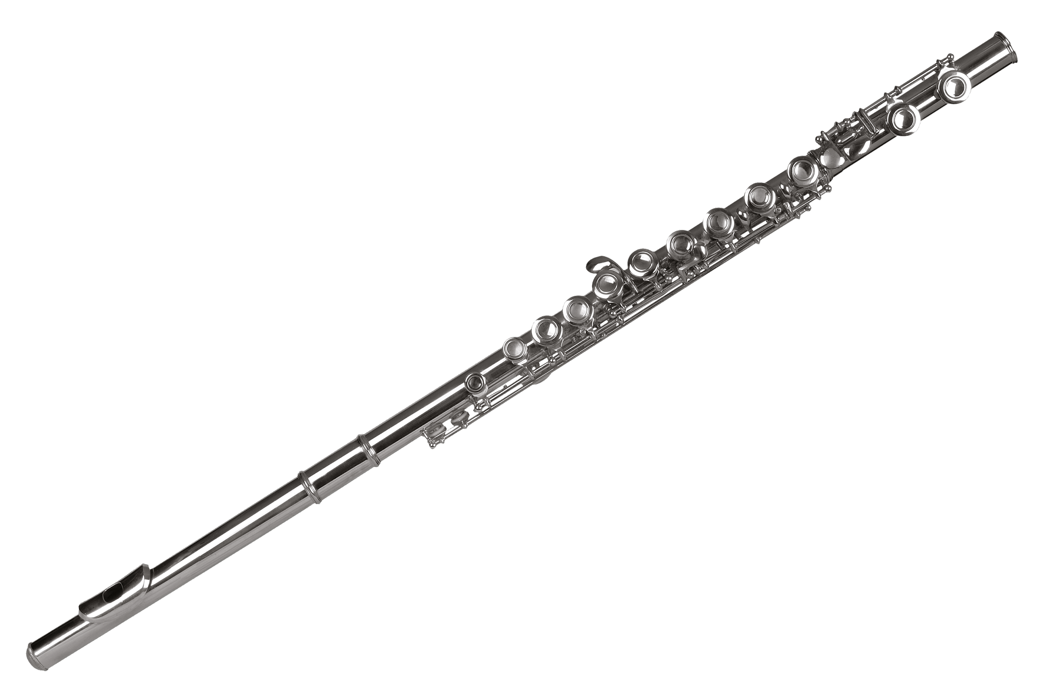
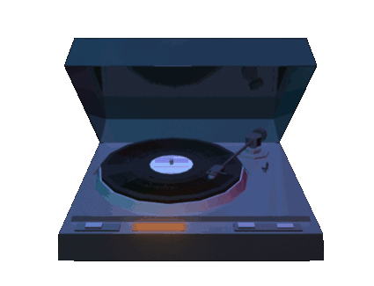
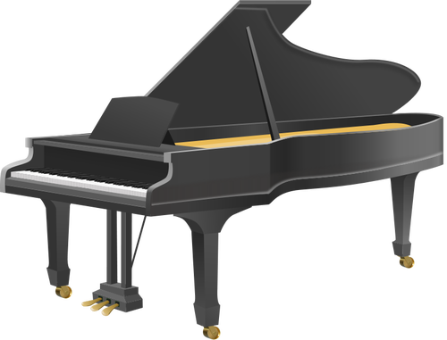
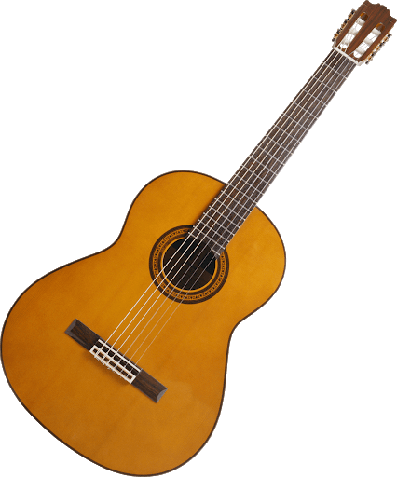

Slide 2
WELCOME TO MRS. PHILLIP’S MUSIC CLASS
Our goal is to provide students with the opportunity to broaden and enrich their musical experiences. The music they perform or study often becomes an integral part of their personal musical repertoire. Creating, performing, and listening to music provides students a unique insight into the form and structure of music and at the same time will help them to develop their creativity and abstract thinking. The role that music will play in students’ lives depends in large measure on the level of skills they achieve in creating, performing and listening to music. Most importantly students will have fun learning and creating music!

Slide 3
Here is a sneak peek of some music we created:
Students had to pick 1 word that described their summer and then play with a boomwhacker that word without saying it.
Here is Mr.. Dorfman’s class song titled………...
“SUMMER”

Slide 4
Orchestra
In our elementary school instrumental music program we aim to provide students with the opportunity to broaden and enrich their musical experiences. The course is designed to provide students with skills that will build on their current level of musical achievement. More specifically we work on instrument proficiency and the fundamentals of the students’ chosen instrument. Building confidence within their own skill set we look further into analyzing music. Understanding the structure of music will guide us into the purpose of the music and the composer's musical decisions. Most importantly, have fun learning and enjoying music!
Orchestra is every Monday at 7:20 am in the music room.

